Slide 1
Ancient Greek for Everyone:
A New Digital Resource for Beginning Greek
Unit 1 part 1: history of the Alphabet and Vowels
2015 edition
Wilfred E. Major
wmajor@lsu.edu

Slide 2
Ancient Greek for Everyone
Review some history about the Greek alphabet.
Learn some Greek letters!

Slide 3
Ancient Greek for Everyone
Understanding a little about the history of the Greek alphabet helps explain why Greek writing looks the way it does (and why our alphabet looks the way it does, too).
In the eighth century B.C., the Greeks began adapting a Phoenician writing system to record Greek.
The Greeks changed the system by dropping consonants that they did not need and adding characters for vowels (not recorded in Phoenician), thus creating the world’s first true alphabet.

Slide 4
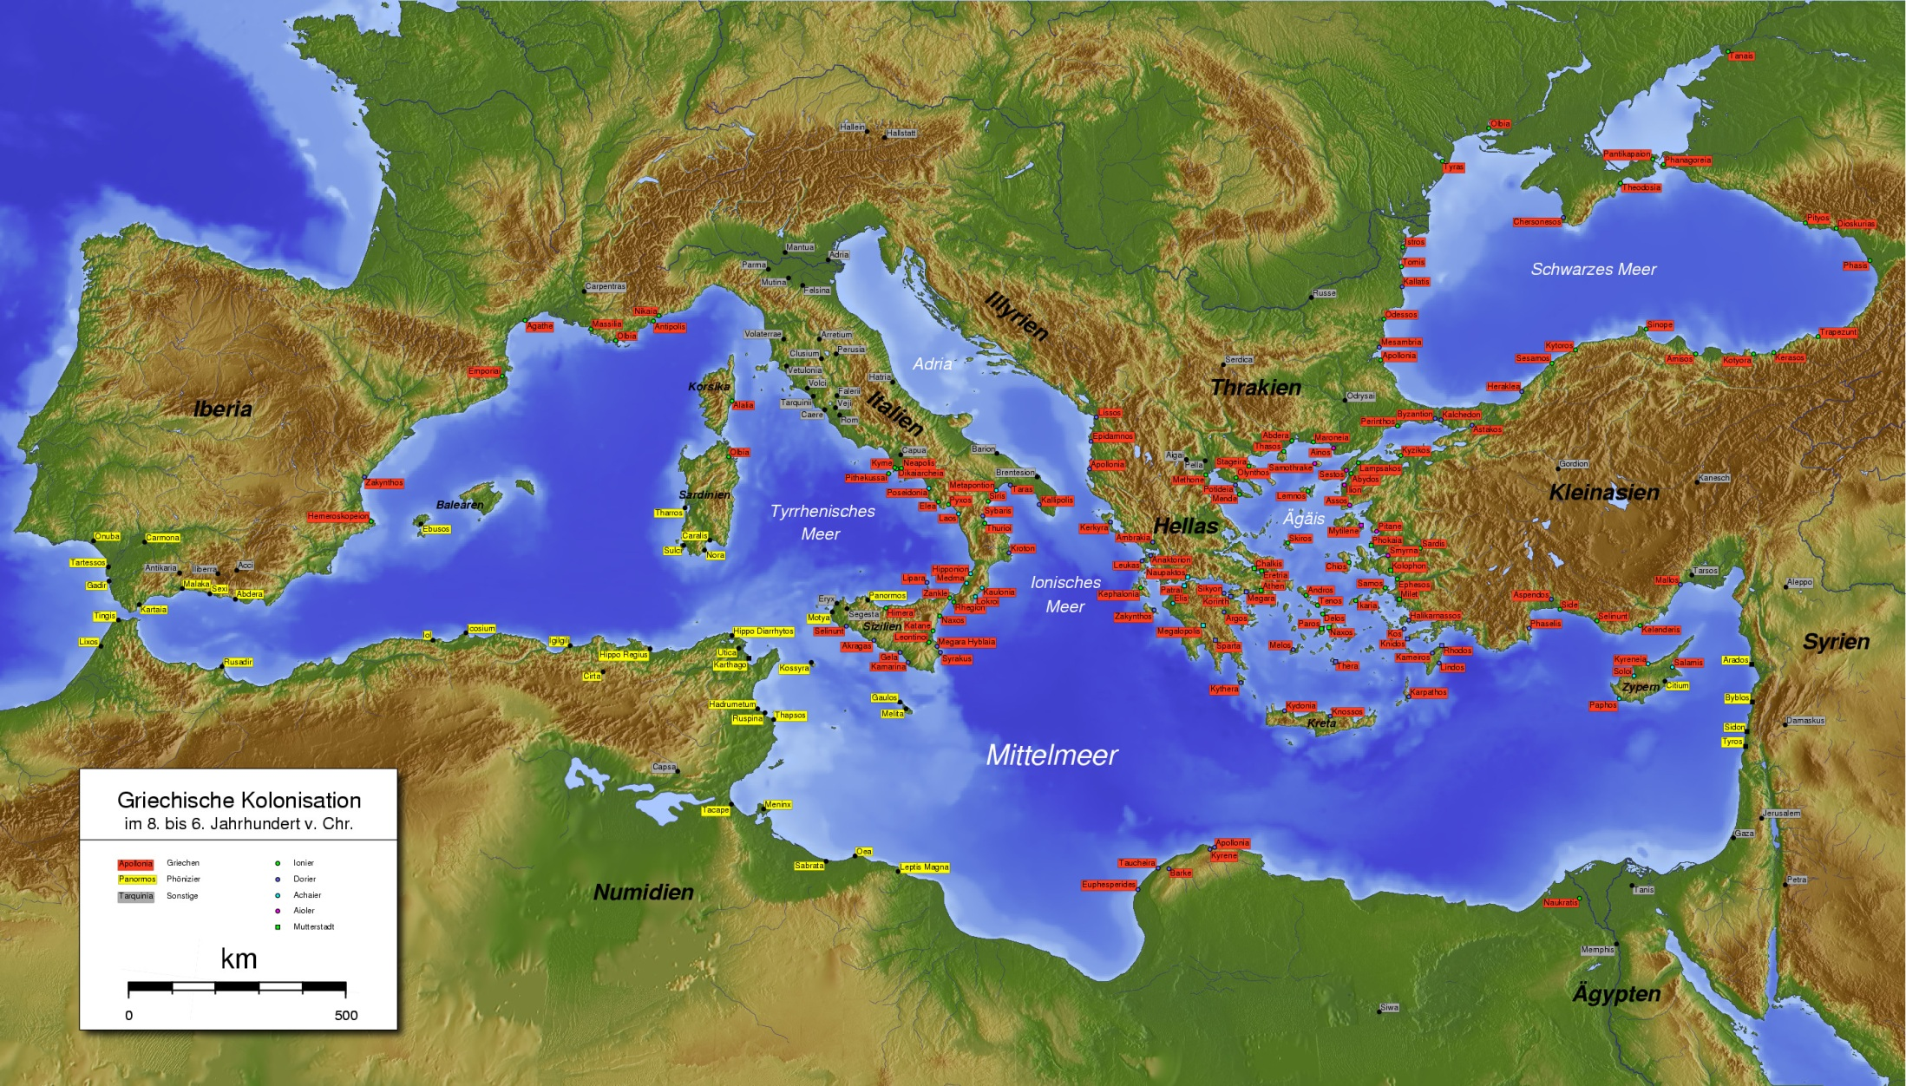
Greek colonies in red
Phoenician colonies in yellow
8th-6th centuries B.C.,
when the Greeks adapted the Phoenician writing system
Notes:
Wikipedia: http://upload.wikimedia.org/wikipedia/commons/f/f4/AntikeGriechen1.jpg

Slide 5
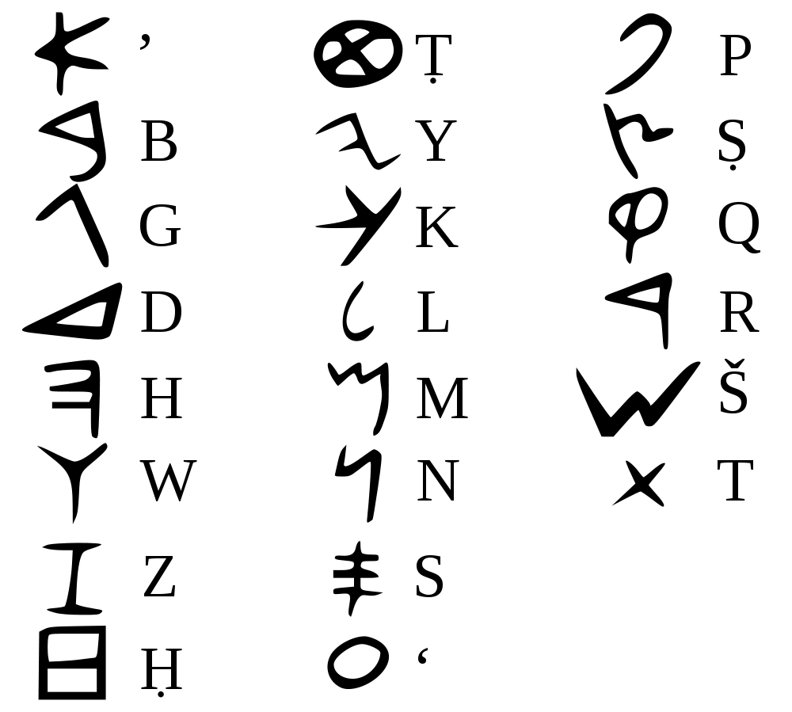
The Phoenician
characters and their sounds
Notes:
Wikipedia: http://upload.wikimedia.org/wikipedia/commons/thumb/2/24/Phoenician_alphabet.svg/1000px-Phoenician_alphabet.svg.png

Slide 6
Ancient Greek for Everyone
As happens with new technology, at first there were multiple versions and formats.
Different communities used the alphabet to record only their local dialect.
Thus for several centuries, different areas would use different sets of letters and different versions of letters (pointing different directions, and so on).
There was also no standard for the direction of script in general (left to right, right to left, and so on).

Slide 7
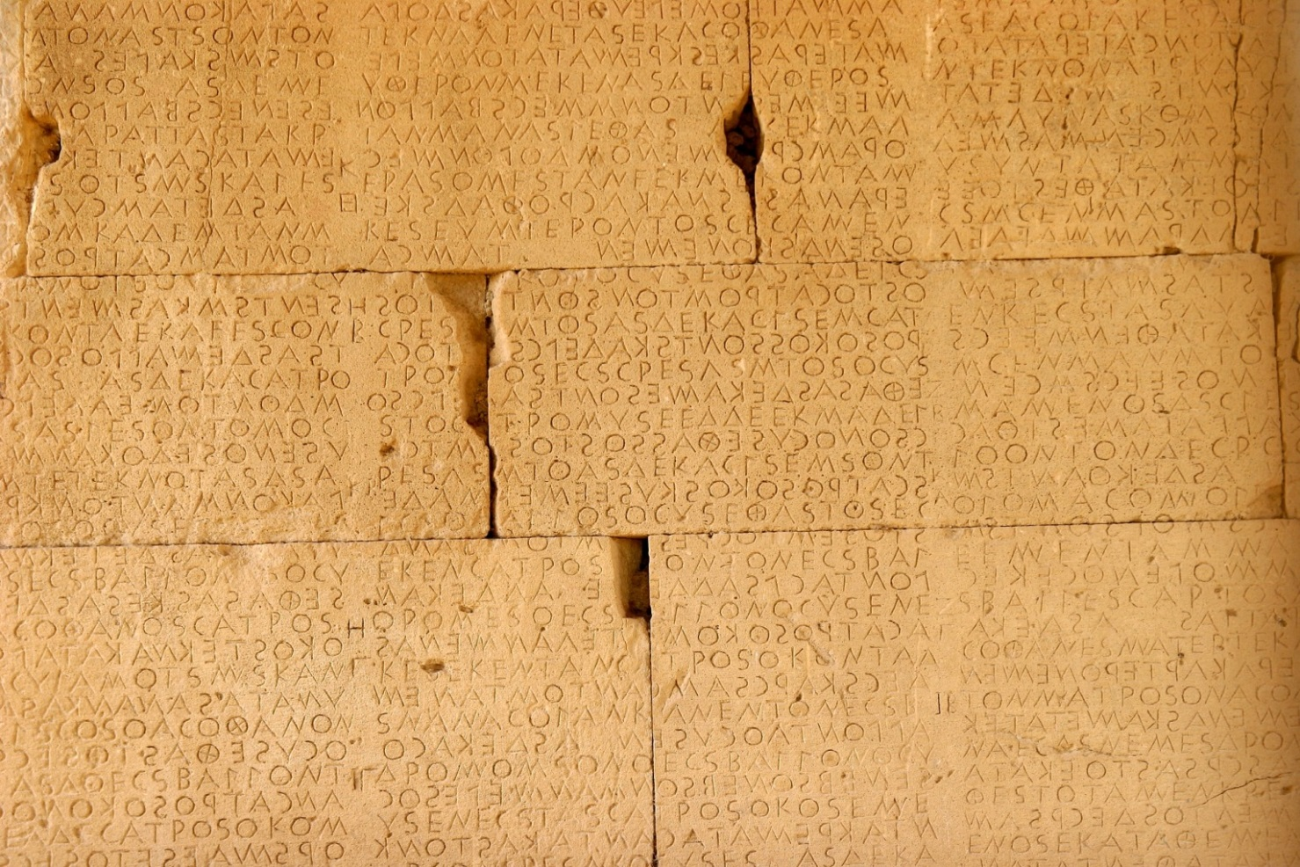
law code of Gortys
(on Crete)
For example, this stone inscription from the fifth century B.C.
is written boustrophedon
(left to right and right to left
alternate each line).
Notes:
Wikipedia: http://upload.wikimedia.org/wikipedia/commons/d/db/Gortys_Law_Code.jpg
source: commons.wikimedia/wiki/File:Boustrophedon.png

Slide 8
Ancient Greek for Everyone
Recall our definition of Classical Greek:
Classical Greek refers to writings from the city of Athens during the fifth and fourth centuries B.C.
In 403 B.C., the city of Athens officially adopted a specific, consistent form of the Greek alphabet.
Because of the influence of Attic Greek, this version of the alphabet became the standard starting point for writing Greek.
Even older writings were rewritten using the standard fourth-century Athenian alphabet.

Slide 9
Ancient Greek for Everyone
The upper case letters:
In the Classical period, much writing was still carved into stone or into clay objects.
This version of the alphabet survives primarily as the upper case alphabet.
People started writing more on papyrus (on early type of paper made from the papyrus reed), but they still used the familiar letters.

Slide 10
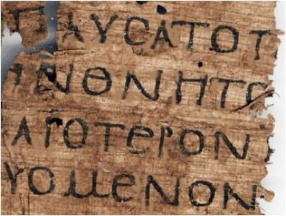
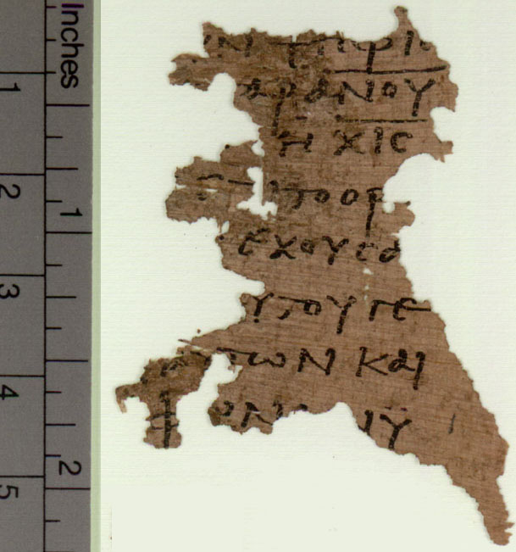
The upper case letters
in early writing on papyrus
papyrus from Plato’s Statesman
P.Oxy. LX 5107
alternate “number of the beast”
P.Oxy. 4499
Notes:
http://quod.lib.umich.edu/i/icp/7523866.0025.146?rgn=main;view=fulltext
http://www.papyrology.ox.ac.uk/POxy/beast/beast616.html

Slide 11
Ancient Greek for Everyone
The lower case letters:
As writing on papyrus, and later on paper, became more common, scribes gradually changed the letters to make them easier to write.
This version of the alphabet became what we learn as the lower case alphabet.
Scribes retained the old letter forms as upper case forms for special uses and decoration.

Slide 12
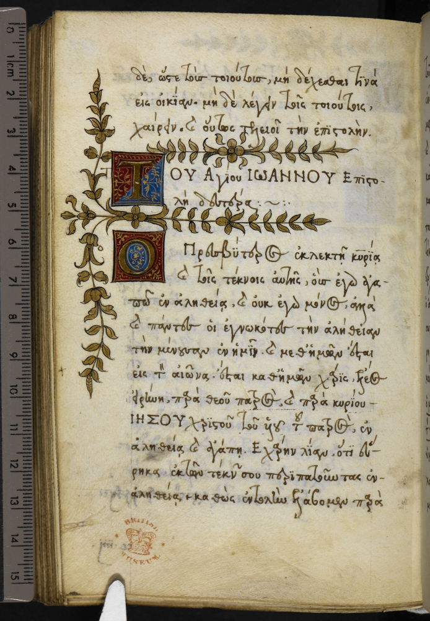
The lower case letters
appear in the
hand-writing from
later manuscripts,
with upper case letters
for special uses.
manuscript of 2 John 1.1-4
Notes:
http://britishlibrary.typepad.co.uk/digitisedmanuscripts/greek-manuscripts/
ΙΩΑΝΝΟΥ Β
2Io 1:1
Ὁ πρεσβύτερος ἐκλεκτῇ κυρίᾳ καὶ τοῖς τέκνοις αὐτῆς, οὓς ἐγὼ ἀγαπῶ ἐν ἀληθείᾳ, καὶ οὐκ ἐγὼ μόνος ἀλλὰ καὶ πάντες οἱ ἐγνωκότες τὴν ἀλήθειαν, 2 διὰ τὴν ἀλήθειαν τὴν μένουσαν ἐν ἡμῖν, καὶ μεθ’ ἡμῶν ἔσται εἰς τὸν αἰῶνα. 3 ἔσται μεθ’ ἡμῶν χάρις ἔλεος εἰρήνη παρὰ θεοῦ πατρός, καὶ παρὰ Ἰησοῦ Χριστοῦ τοῦ υἱοῦ τοῦ πατρός, ἐν ἀληθείᾳ καὶ ἀγάπῃ. 4 Ἐχάρην λίαν ὅτι εὕρηκα ἐκ τῶν τέκνων σου περιπατοῦντας ἐν ἀληθείᾳ, καθὼς ἐντολὴν ἐλάβομεν παρὰ

Slide 13
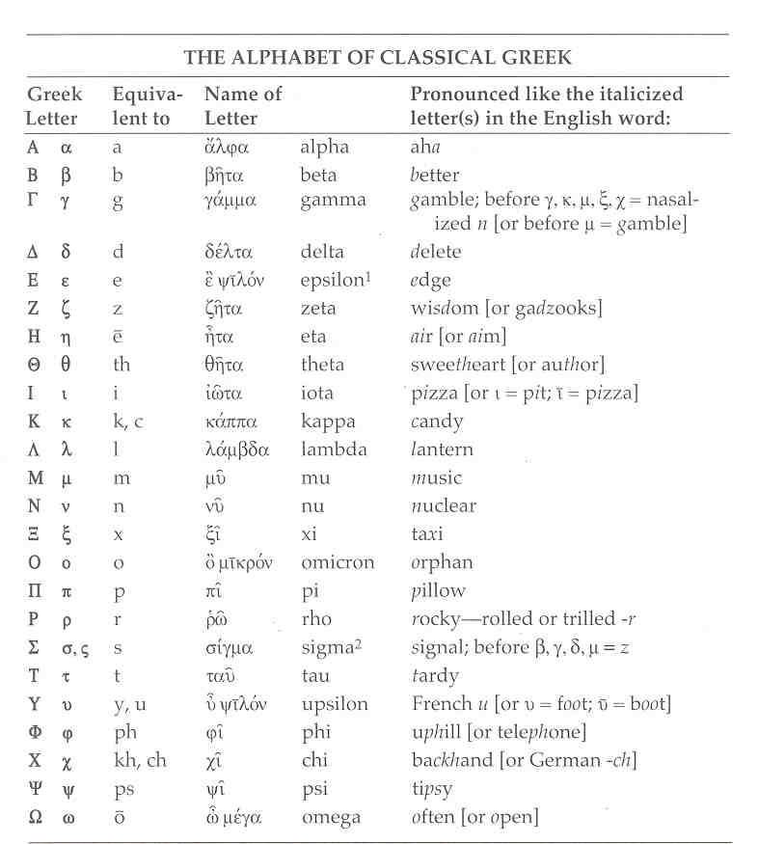
The
Classical Greek
alphabet
for the
printing press
capitals and cursives
combined

Slide 14
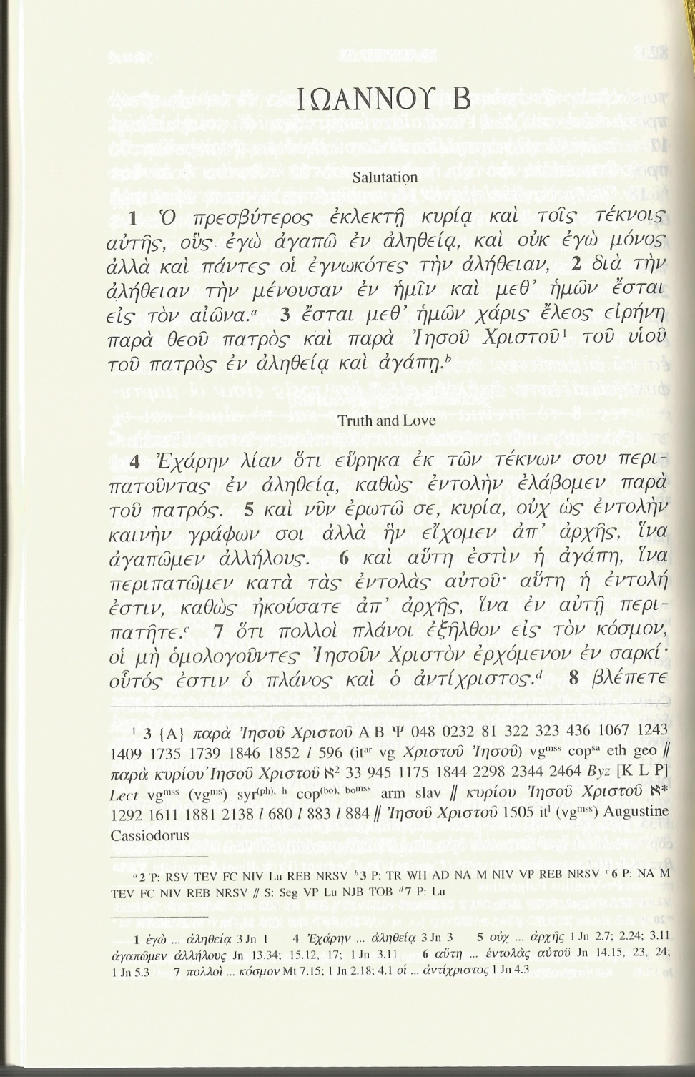
From manuscript to modern printed edition
Notes:
http://britishlibrary.typepad.co.uk/digitisedmanuscripts/greek-manuscripts/
ΙΩΑΝΝΟΥ Β
2Io 1:1
Ὁ πρεσβύτερος ἐκλεκτῇ κυρίᾳ καὶ τοῖς τέκνοις αὐτῆς, οὓς ἐγὼ ἀγαπῶ ἐν ἀληθείᾳ, καὶ οὐκ ἐγὼ μόνος ἀλλὰ καὶ πάντες οἱ ἐγνωκότες τὴν ἀλήθειαν, 2 διὰ τὴν ἀλήθειαν τὴν μένουσαν ἐν ἡμῖν, καὶ μεθ’ ἡμῶν ἔσται εἰς τὸν αἰῶνα. 3 ἔσται μεθ’ ἡμῶν χάρις ἔλεος εἰρήνη παρὰ θεοῦ πατρός, καὶ παρὰ Ἰησοῦ Χριστοῦ τοῦ υἱοῦ τοῦ πατρός, ἐν ἀληθείᾳ καὶ ἀγάπῃ. 4 Ἐχάρην λίαν ὅτι εὕρηκα ἐκ τῶν τέκνων σου περιπατοῦντας ἐν ἀληθείᾳ, καθὼς ἐντολὴν ἐλάβομεν παρὰ

Slide 15
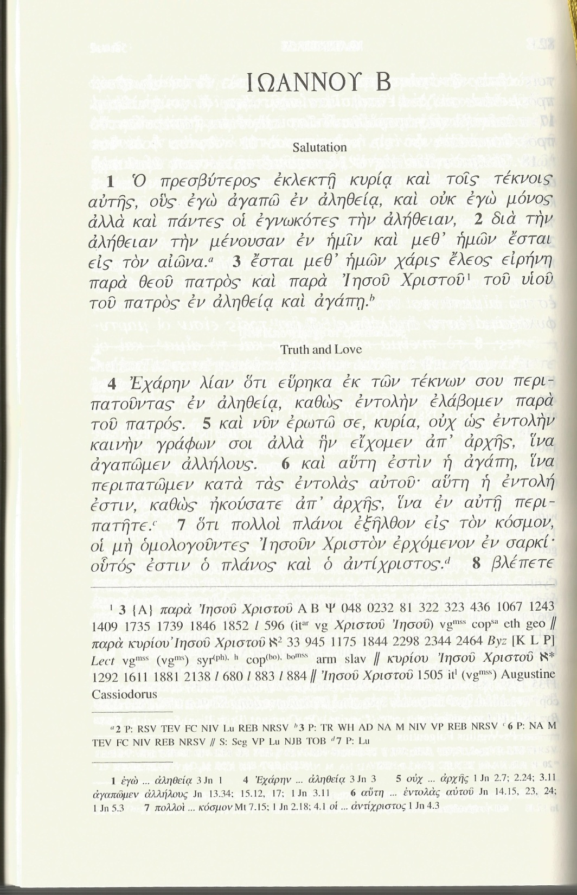
Printed editions
began as reproductions
of manuscripts,
so modern editions
generally retain this use of the
lower and upper case letters.
modern printed edition of 2 John 1.1-4

Slide 16
Ancient Greek for Everyone
Printed texts still use lower case letters normally, but use upper case letters for
the first letter of a proper name (person, place, etc)
the first letter of a direct quotation
sometimes the beginning of a paragraph
But inscriptions and other non-printed Greek (e.g., on shirts) still tend to use the upper case letters!

Slide 17
Ancient Greek for Everyone
Imagine if English were printed in a cursive script all the time.
Imagine if English were printed in a cursive script all the time.
This is why printed Greek texts can look like chicken scratch, but once you know the alphabet, it is just like reading someone’s handwriting.

Slide 18
Ancient Greek for Everyone
An essential principle about the ancient Greek alphabet:
SPELL IT LIKE IT SOUNDS!
Greeks in antiquity spelled words the way they pronounced them.
If they changed the pronunciation of a word, they changed the spelling to match.

Slide 19
Ancient Greek for Everyone
An essential principle about the ancient Greek alphabet:
SPELL IT LIKE IT SOUNDS!
Consider the verb “record” (reCORD)
and the noun “record” (RECord),
which are spelled alike but pronounced differently in English.
In Greek, such words would be spelled according to their pronunciations: “rikórd” and “rékerd”

Slide 20
Ancient Greek for Everyone
An essential principle about the ancient Greek alphabet:
SPELL IT LIKE IT SOUNDS!
Imagine these examples in English:
If anyone pronounced “going” as “gonna,”
they would spell it “gonna.”
Homophones like “but” and “butt” would both be spelled “but,” even though they have different meanings.

Slide 21
Ancient Greek for Everyone
Therefore, the surest and most straightforward way to become comfortable reading and writing Greek is to sound out the words and match the sounds to the letters.
SPELL IT LIKE IT SOUNDS!

Slide 22
Ancient Greek for Everyone
Now we start learning the Greek alphabet.
We learn how to make the letters, but equally importantly, what sounds the letters represent.
Whereas in English, the consonants tend to dominate, in Greek the vowels are more important.
So we start with the Greek vowels.

Slide 23
Ancient Greek for Everyone
VOWELS
Greek has roughly the same five vowels as English:
α “ah”
ε “eh”
ι “ih”
ο “o”
υ “u”

Slide 24
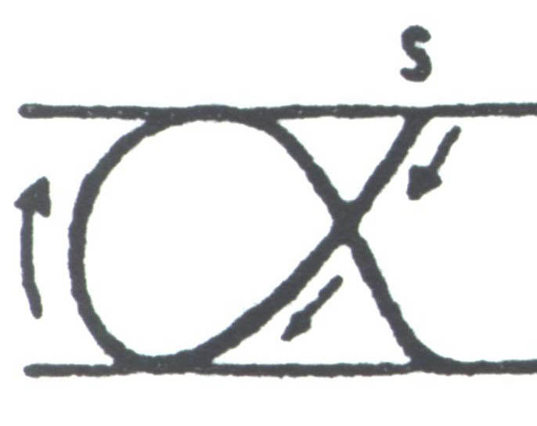
letter name sound English
Α α “alpha” = “ah” = A a
Notes:
Letter drawing from Nina Barclay. Eucleides' World: An Exploratory Introduction to Ancient Greek to Accompany Ecce Romani. CANE (Classical Association of New England), 2002.

Slide 25
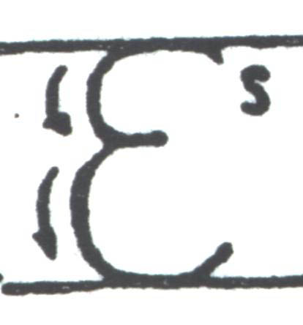
letter name sound English
Ε ε “epsilon” = “eh” = E e
Notes:
Letter drawing from Nina Barclay. Eucleides' World: An Exploratory Introduction to Ancient Greek to Accompany Ecce Romani. CANE (Classical Association of New England), 2002.

Slide 26
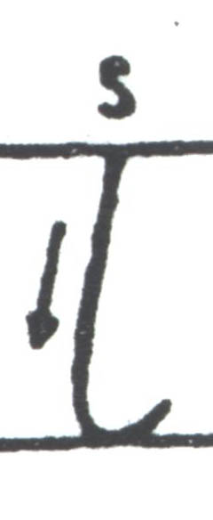
letter name sound English
Ι ι “iota” = “ih” = I i
Notes:
Letter drawing from Nina Barclay. Eucleides' World: An Exploratory Introduction to Ancient Greek to Accompany Ecce Romani. CANE (Classical Association of New England), 2002.

Slide 27
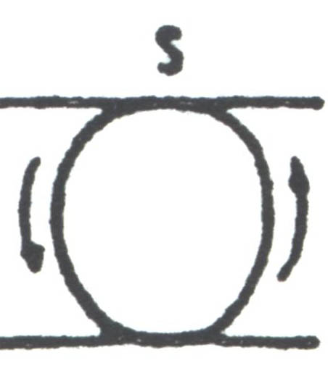
letter name sound English
Ο ο “omicron” = “o” = O o
Notes:
Letter drawing from Nina Barclay. Eucleides' World: An Exploratory Introduction to Ancient Greek to Accompany Ecce Romani. CANE (Classical Association of New England), 2002.

Slide 28
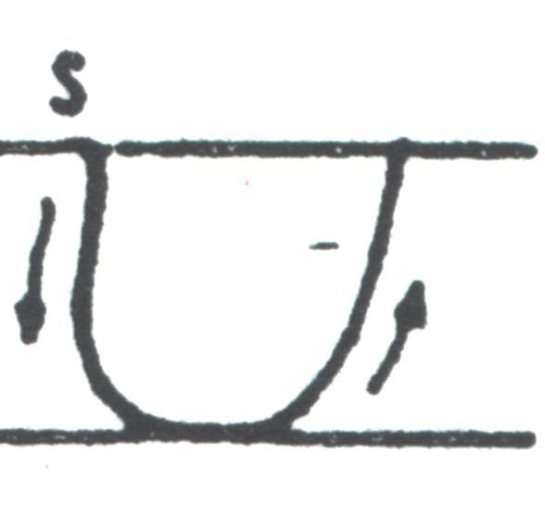
letter name sound English
Υ υ “upsilon” = “u” = Y y
Notes:
Letter drawing from Nina Barclay. Eucleides' World: An Exploratory Introduction to Ancient Greek to Accompany Ecce Romani. CANE (Classical Association of New England), 2002.

Slide 29
Ancient Greek for Everyone
Short
Long
α “ah”
ε “eh”
ι “ih”
ο “o”
υ “u”
ᾱ “aah”
η “ay”
ῑ “ee”
ω “oh”
ῡ “οοh”
Like English, Greek has short and long versions of its vowels.

Slide 30
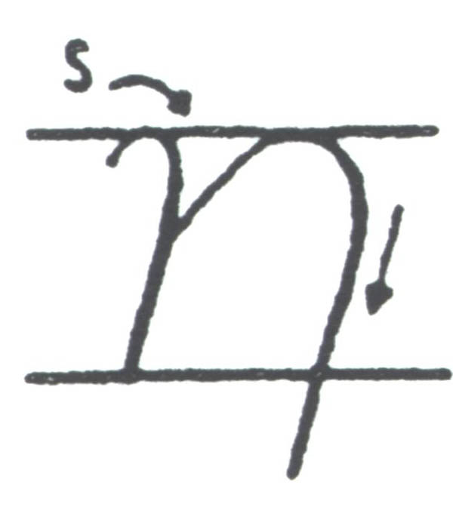
letter name sound English
Η η “eta” = “ay” = E e
Notes:
Letter drawing from Nina Barclay. Eucleides' World: An Exploratory Introduction to Ancient Greek to Accompany Ecce Romani. CANE (Classical Association of New England), 2002.

Slide 31
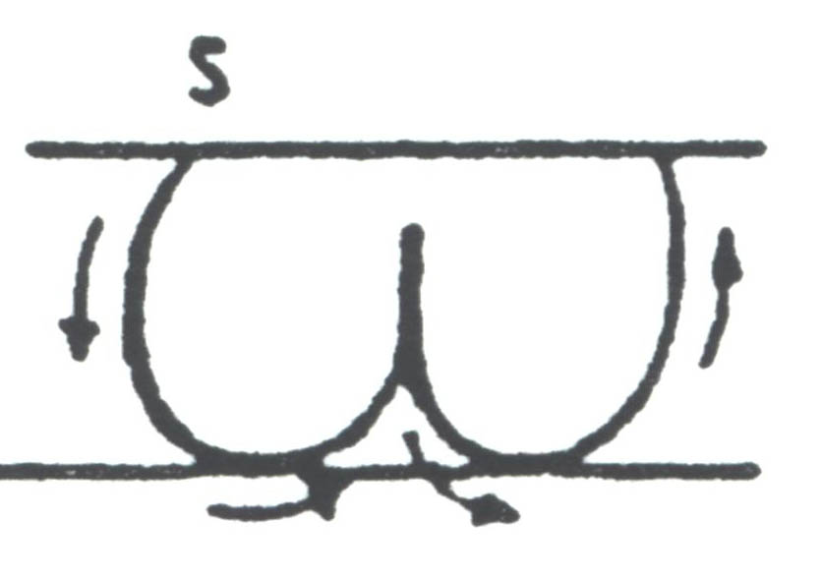
letter name sound English
Ω ω “omega” = “oh” = O o
Notes:
Letter drawing from Nina Barclay. Eucleides' World: An Exploratory Introduction to Ancient Greek to Accompany Ecce Romani. CANE (Classical Association of New England), 2002.

Slide 32
Ancient Greek for Everyone
Saying two vowels in a row
Speakers of Classical Greek did not like to say
  two vowel sounds in a row.
Consequently, if two vowels came together,
they tended to merge them into one
    (called a “diphthong,” Greek for “double sound”)
  or contract them.
Specifically:
  A vowel + ι or υ forms a diphthong.
  α, ε and ο contract with each other.

Slide 33
Ancient Greek for Everyone
A vowel + ι forms a diphthong:
α + ι = αι “eye”
  ᾱ + ι = ᾱι “aah” usually written ᾳ
ε + ι = ει “ay”
  η + ι = ηι “ay” usually written ῃ
ο + ι = οι “oy”
  ω + ι = ωι “oh” usually written ῳ
υ + ι = υι “wee”

Slide 34
Ancient Greek for Everyone
A vowel + υ forms a diphthong:
α + υ = αυ “ow!”
ε + υ = ευ “eu”
ο + υ = ου “oo”

Slide 35
Ancient Greek for Everyone
α, ε and ο + α contract:
α + α = ᾱ
ε + α = η
ο + α = ω

Slide 36
Ancient Greek for Everyone
α, ε and ο + ε contract:
α + ε = ᾱ
ε + ε = ει
ο + ε = ου

Slide 37
Ancient Greek for Everyone
α, ε and ο + ο contract:
α + ο = ω
ε + ο = ου
ο + ο = ου

Slide 38
Ancient Greek for Everyone
Next
  Greek consonants!

